Slide 1
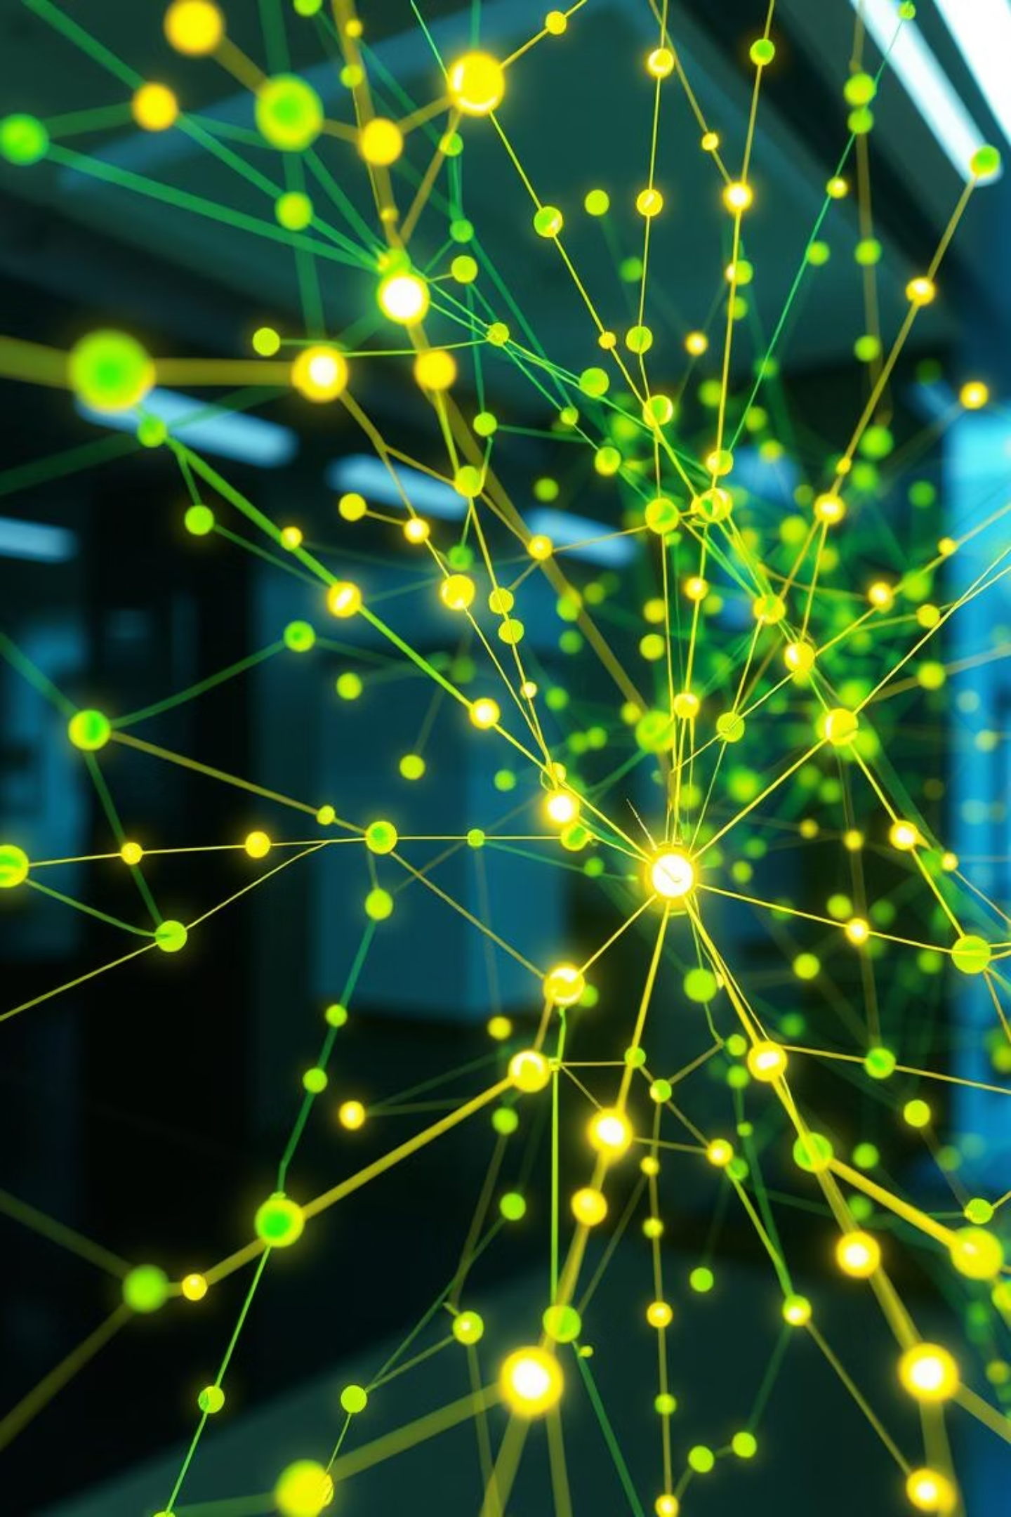
Unlocking Insights: Unsupervised Learning with K-Means & DBSCAN
Welcome to this deep dive into Unsupervised Learning, where we'll explore how K-Means and DBSCAN clustering algorithms help us discover hidden patterns in data.

Slide 2



What is Unsupervised Learning?
Unsupervised learning is a branch of machine learning that learns patterns from unlabeled data, meaning there are no predefined categories or outputs to guide the algorithm.
Pattern Discovery
Unlike supervised learning, which requires human-labeled datasets, unsupervised methods automatically find structure and relationships within the data.
Identifies underlying structures in data.
Anomaly Detection
Flags unusual data points or events.
Clustering
Groups similar data points together.

Slide 3
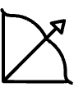

Clustering Algorithms Overview
Clustering is the process of dividing a dataset into groups of similar data points. We'll focus on two prominent algorithms: K-Means and DBSCAN.
K-Means
DBSCAN
Partitions data into a user-defined number of 'k' clusters.
Identifies clusters based on the density of data points.
Based on the concept of centroids (mean position of cluster).
Can discover arbitrarily shaped clusters.
The choice between them largely depends on your data's characteristics and the problem you're trying to solve.

Slide 4
How K-Means Works
K-Means is an iterative algorithm that aims to partition 'n' observations into 'k' clusters, where each observation belongs to the cluster with the nearest mean (centroid).
1. Specify K
You define the number of clusters (k) upfront.
2. Initialize Centroids
Randomly place k initial cluster centroids within the data.
3. Assign Points
Each data point is assigned to the nearest centroid.
4. Update Centroids
Centroids are recalculated as the mean of all assigned points.
5. Repeat
Steps 3-4 repeat until centroids no longer significantly change.

Slide 5
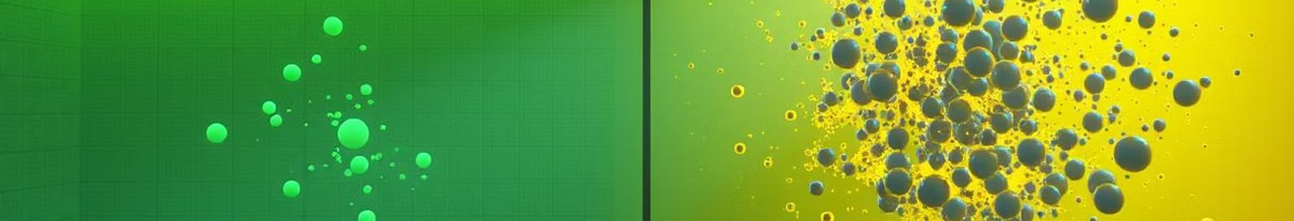
K-Means: Strengths & Limitations
Advantages
Limitations
Simplicity and Speed: Relatively straightforward to implement and computationally efficient, even for large datasets.
Requires 'k': The number of clusters must be specified in advance, which is often unknown.
Scalability: Can handle a high number of observations and dimensions effectively.
Initial Centroid Sensitivity: Results can vary significantly based on the initial placement of centroids.
Well-defined Clusters: Performs exceptionally well when clusters are spherical, evenly sized, and well-separated.
Irregular Shapes: Struggles with non-spherical clusters or clusters of varying densities and sizes.
Outlier Sensitivity: Outliers can disproportionately affect centroid positions.

Slide 6
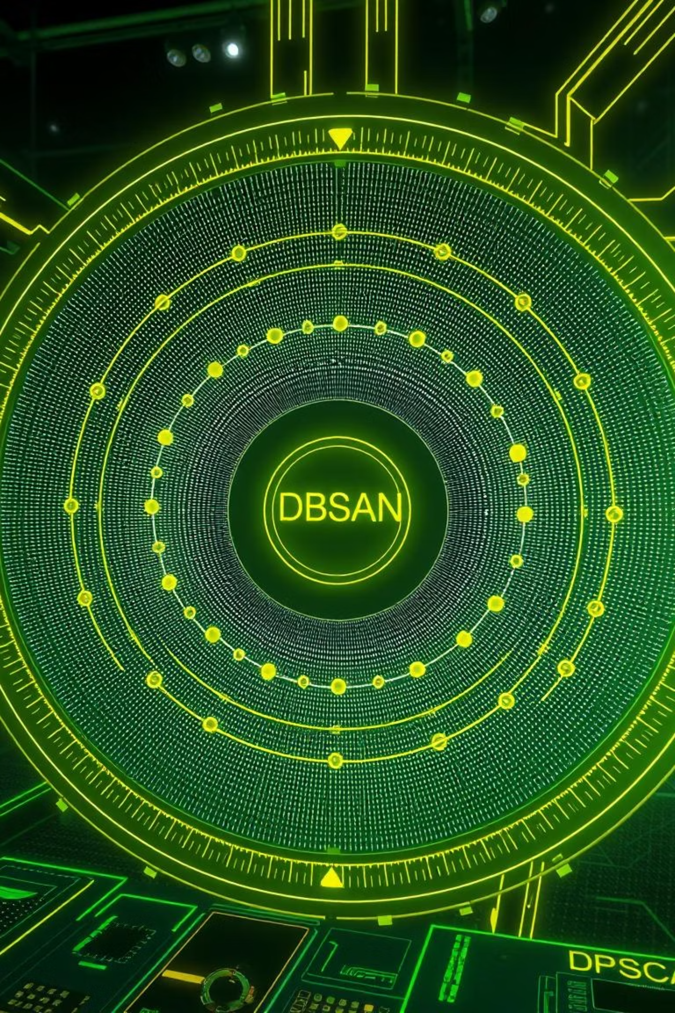
How DBSCAN Works
DBSCAN (Density-Based Spatial Clustering of Applications with Noise) groups together points that are closely packed together, marking as outliers points that lie alone in low-density regions.
Core Points
Border Points
A point is a core point if it has at least 'MinPts' neighbors within a distance 'ε' (epsilon).
A point is a border point if it is within 'ε' distance of a core point but has less than 'MinPts' neighbors.
Noise Points
Points that are neither core nor border points are considered noise or outliers.
Unlike K-Means, DBSCAN doesn't require knowing the number of clusters beforehand and can effectively identify noise.

Slide 7
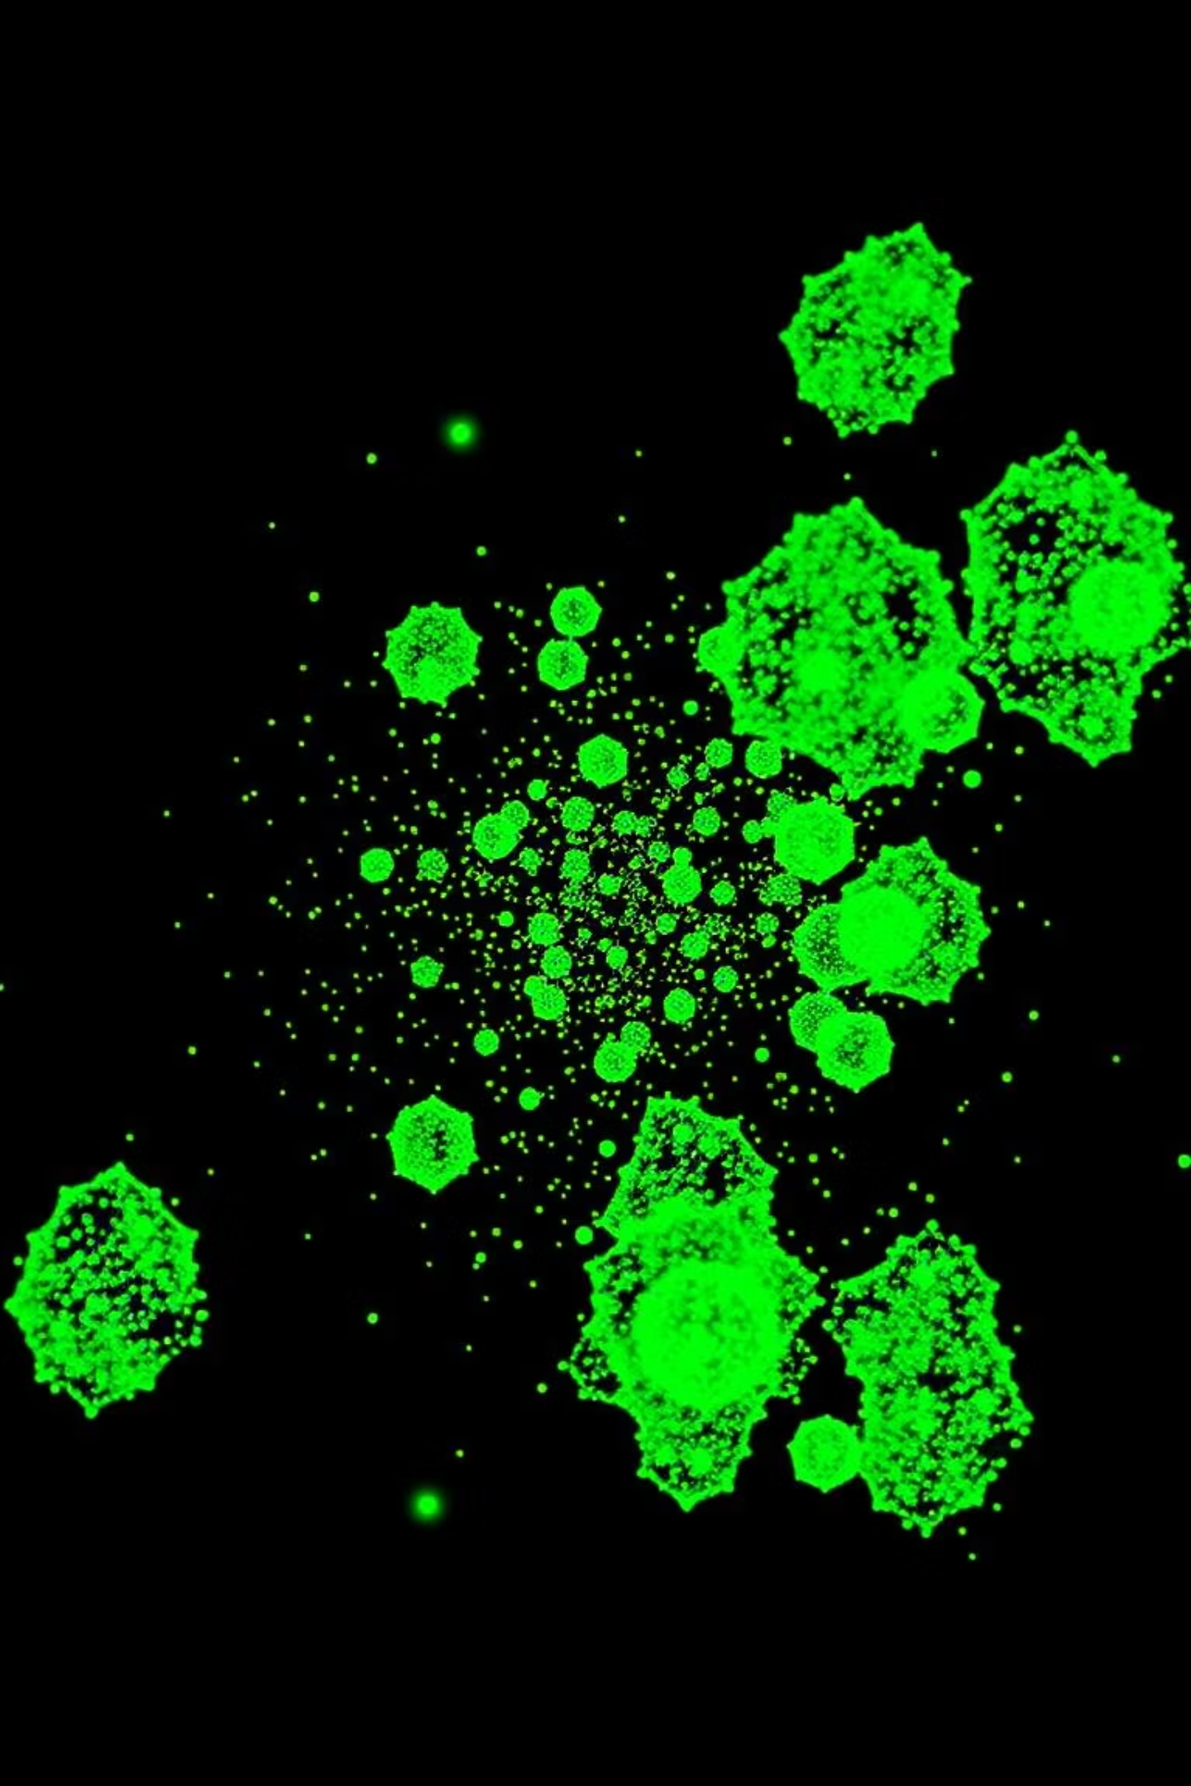
DBSCAN: Strengths & Limitations
Advantages
Limitations
Arbitrary Shapes: Capable of finding clusters of any shape, not just spherical.
Parameter Sensitivity: Performance heavily depends on the choice of 'ε' (epsilon) and 'MinPts'.
Noise Robustness: Naturally identifies and handles outliers and noisy data.
Varying Densities: Struggles with clusters of significantly different densities, as it uses global parameters.
No 'k' Required: Does not need the number of clusters to be specified upfront, as it discovers them automatically.
High-Dimensional Data: Can become less effective in very high-dimensional spaces due to the "curse of dimensionality."

Slide 8
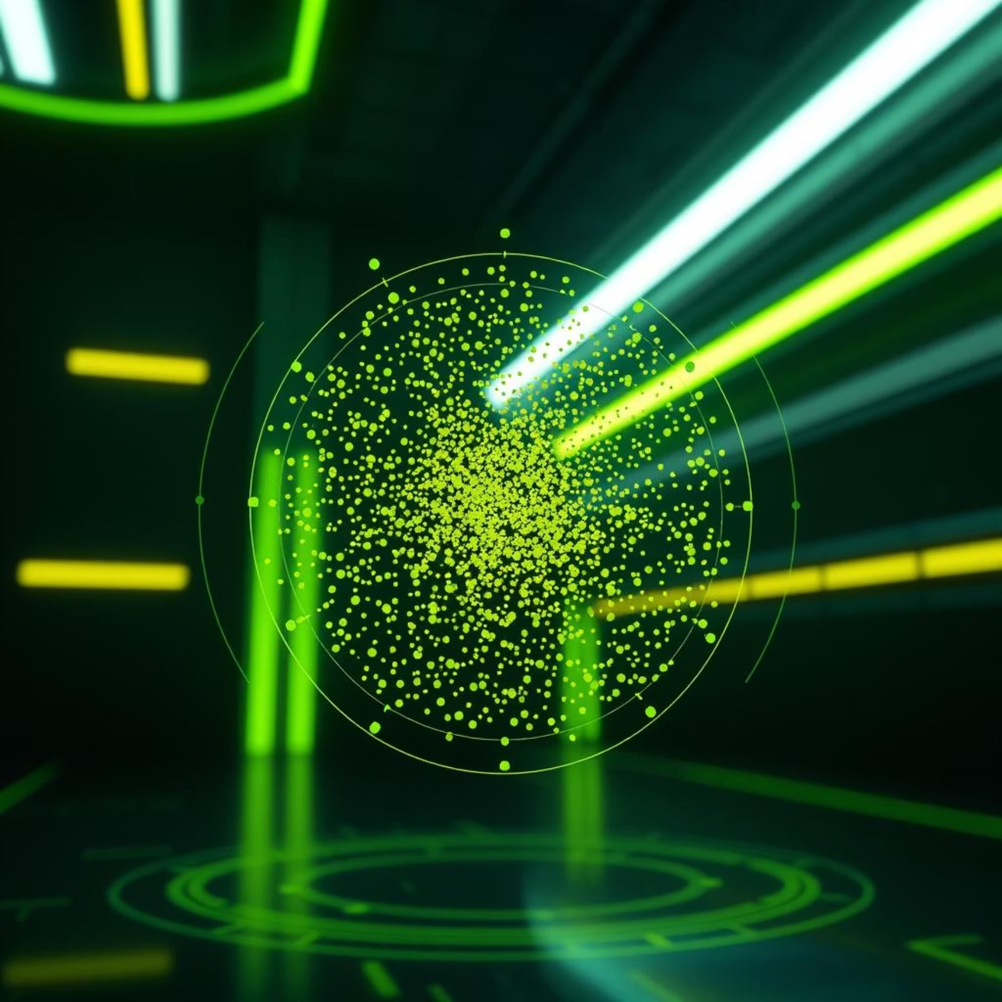
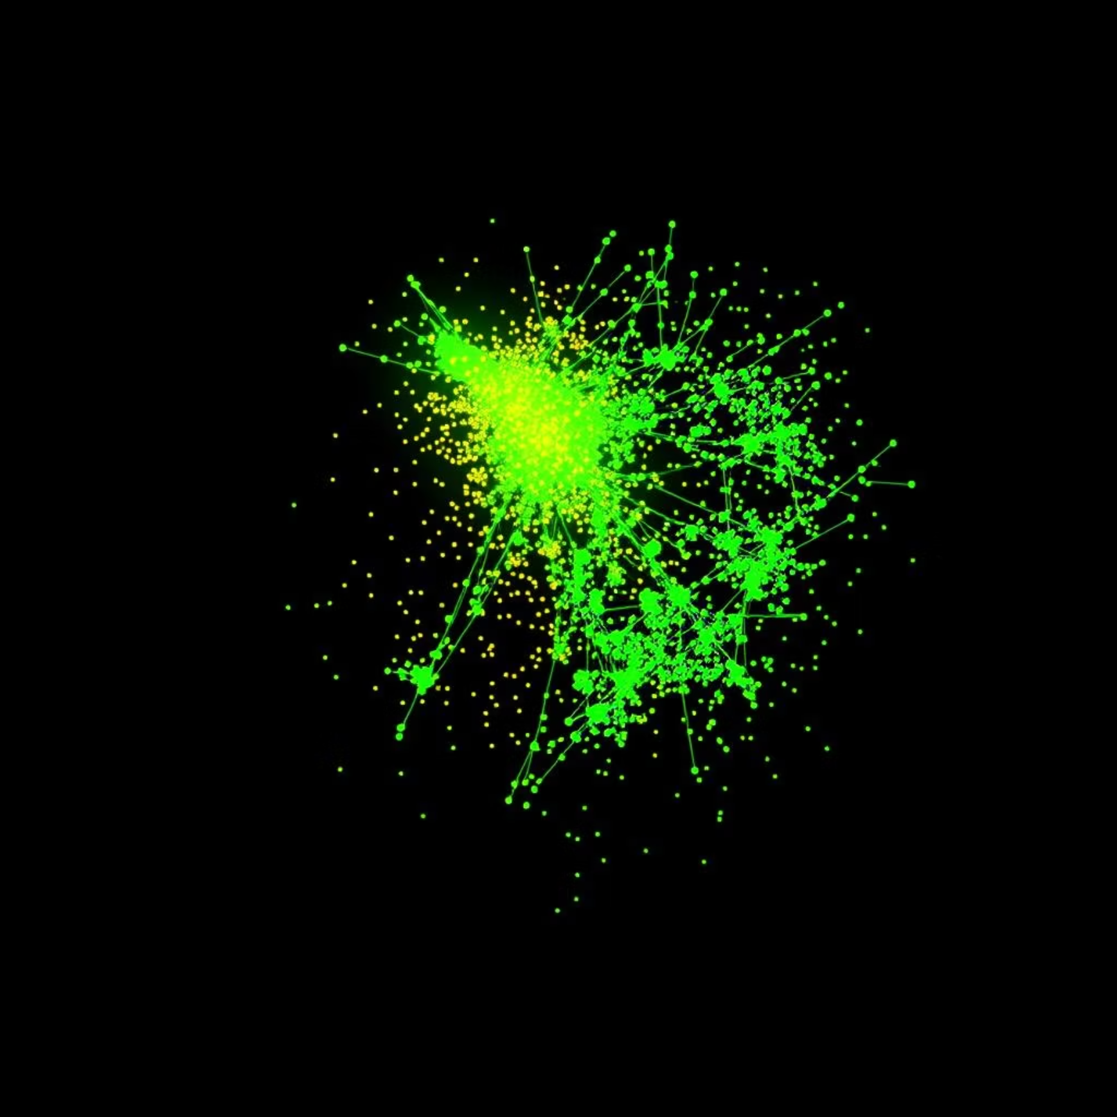
Visual Comparison: K-Means vs. DBSCAN
K-Means
DBSCAN
Assumes clusters are spherical and of similar size.
Identifies arbitrarily shaped clusters based on density.
Forces every data point into a cluster, even outliers.
Capable of detecting and isolating noise/outliers.
Struggles with noise and complex cluster geometries.
Excels where clusters are not well-separated or are non-convex.

Slide 9
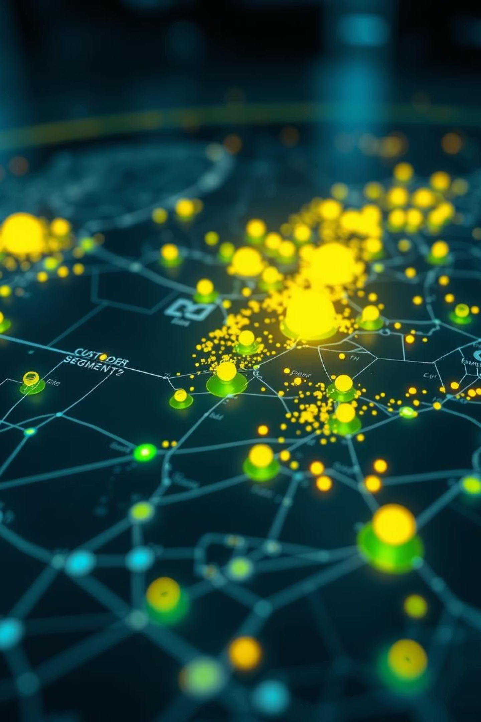
Practical Use Cases
K-Means
Customer Segmentation: Grouping customers into distinct segments for targeted marketing campaigns (e.g., high-value, at-risk).
1
Document Classification: Organizing large corpuses of text into thematic groups.
Market Regime Classification: Identifying different states of financial markets (e.g., bullish, bearish, sideways) based on price data.
DBSCAN
Anomaly Detection: Pinpointing unusual patterns in network traffic for cybersecurity or identifying fraudulent transactions.
2
Geospatial Clustering: Finding crime hotspots or identifying areas with high concentrations of certain events, where shapes are often irregular.
Medical Image Analysis: Identifying dense regions or anomalies in medical scans without assuming cluster shapes.

Slide 10
Summary & Takeaways
K-Means: Efficient & Intuitive
DBSCAN: Robust & Flexible
Choose Wisely & Experiment
Ideal for noisy datasets with arbitrarily shaped clusters, and when the number of clusters is unknown. Automatically identifies outliers.
The "best" algorithm depends on your data's characteristics and your specific problem. Always visualize your data and experiment with parameters to achieve optimal results.
Best for well-separated, spherical clusters when the number of clusters is known or can be estimated. Simple to implement and computationally fast.
Unsupervised learning empowers us to discover hidden stories in our data.

